Slide 1
How to be friendly with Microorganisms
Prin.Dr R. S. Awasthi
Shivaji College,Renapur,Latur,413527

Slide 2
Teaching Objectives
To introduce the following:
The extent of the microbial world
Fundamental techniques

Slide 3
Learning Outcomes…I
At the end of this section, students will have an appreciation of &/or be able to:
The important developments in Microbiology
Describe basic and specialised microscopy techniques and their applications
The extent of the microbial world

Slide 4
Lecture Plan
Scope of Microbiology
Extent of the microbial world
Techniques
Microscopy and Staining
Pure culture methods

Slide 5
Introduction
“microbiology’ - the study of microorganisms
organisms to small to be seen with the naked eye
except in large groups
effects of large numbers often visible
e.g., chemical reactions in soil horizons
e.g., toxin and gas production in incompletely sterilised food cans
e.g., disease in animals and plants

Slide 6
Microbial World
Viruses
Bacteria (Eubacteria) and Archaeabacteria
Fungi (Yeasts and Molds)
Protozoa
Microscopic Algae

Slide 7
Benefits
Maintain balance of environment (microbial ecology)
Basis of food chain
Nitrogen fixation
Photosynthesis
Digestion, synthesis of vitamins
Manufacture of food and drink

Slide 8
Benefits
Genetic engineering
Synthesis of chemical products
Recycling sewage
Bioremediation: use microbes to remove toxins (oil spills)
Use of microbes to control crop pests
Normal microbiota

Slide 9
Harmful Effects
Cause disease (basis for bioterrorism)
Food spoilage

Slide 10
Branches of Microbiology
Bacteriology: study of bacteria
Mycology: study of fungi
Immunology: study of immunity
Edward Jenner, UK: developed vaccination (1798)
Metchnikoff, RU: discovered phagocytes (1884)
Paul Ehrlich, DE: theory of immunity (1890)
Virology: study of viruses
Beijerinck, NE: discovered intracellular reproduction of TMV; coined the term “virus” (1899)

Slide 11
Branches of Microbiology
Parasitology: study of protozoa and parasitic worms
Chemotherapy
Treatment of disease by using chemical means
Antibiotics produced naturally
Synthetic drugs
Paul Ehrlich (1878) – used arsenic compounds to fight disease – ‘magic bullet’

Slide 12
Branches of Microbiology
Chemotherapy
Alexander Fleming, Scotland (1928) discovered penicillin
Selman Waksman, Ukraine (1944) discovered streptomycin
Problems
Toxicity of drugs => Selective toxicity
Resistance of bacteria to drugs

Slide 13
Branches of Microbiology
Recombinant DNA Technology
Recombinant DNA
Genetic engineering/biotechnology
Microbial genetics – mechanism by which microbes inherit genes
Molecular biology – structure and function (expression) of genes
Molecular epidemiology/diagnostics
Notes:
Beadle and Tatum (1941) – demonstrated the relationship between genes and enzymes
Avery, MacLeod and McCarty (1944) – established that DNA (not protein) was the hereditary material
Lederberg and Tatum (1946) – discovered the transmissibility of the genetic material between bacteria via conjugation.
Watson and Crick (1953) – proposed the model for the structure and replication of DNA
Jacob and Monod (1961) – discovered messenger RNA

Slide 14
Branches of Microbiology
Biotechnology
GMOs/GEMs for industrial, pharmaceutical and agricultural applications
Improvements of agriculture (plants and animals)
Gene therapy: inserting a missing gene or replacing a defective one in human cells

Slide 15
Basic techniques needed to study Bacteria
1. Grow Bacteria
2. Isolate Bacteria
3. Grow Bacteria in pure culture
4. Observe Bacteria
5. Identify Bacteria

Slide 16
Microscope
Resolving Power - ability to distinguish two distinct points
absolute limit of the Resolving Power is about 1/2 the wavelength of light that is used to illuminate the specimen

Slide 17
Preparing smears for staining
1. Bacteria on slide
2. Air Dry
3. Bacteria are HEAT FIXED to the slide
4. Stain is applied

Slide 18
Staining Reaction
Stains - salts composed of a positive and negative ion, one of which is colored (chromophore)
Basic Dyes - chromophore is the positive ion
dye+ Cl-
Acid Dyes - chromophore is the negative ion
Na+ dye-

Slide 19
Bacteria are slightly negative, so are attracted to the positive chromophore of the BASIC DYE
Common Basic Dyes
crystal violet
methylene blue
safranin
basic fuchsin

Slide 20
Acid Dyes - used for Negative Staining (background is stained)
Mordant - intensifies the stain or coats a structure to make it thicker and easier to see after it is stained
Example:
Flagella - can not normally be seen, but a mordant can be used to increase the diameter of the flagella before it is stained
Salmonella typhosa

Slide 21
Differential Stains
React differently with different types of bacteria
2 Most Common
Gram Stain
Acid-Fast Stain

Slide 22
Gram Stain
1884 Hans Christian Gram
most important stain used in Bacteriology
Divides all Bacteria into 2 groups:
Gram (+)
Gram (-)

Slide 23
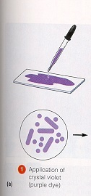
Gram Stain
1. Crystal violet

Slide 24
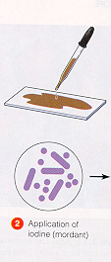
Gram Stain
2. Grams Iodine (mordant)

Slide 25
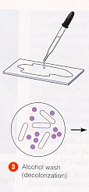
Gram Stain
3. Alcohol

Slide 26
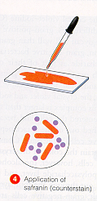
Gram Stain
4. Safranin (Counterstain)

Slide 27
Results
Gram (+) Purple
Gram (-) Red
Difference - due to structure of cell wall
Gram (+) Thick cell wall
Gram (-) Thin cell wall

Slide 28
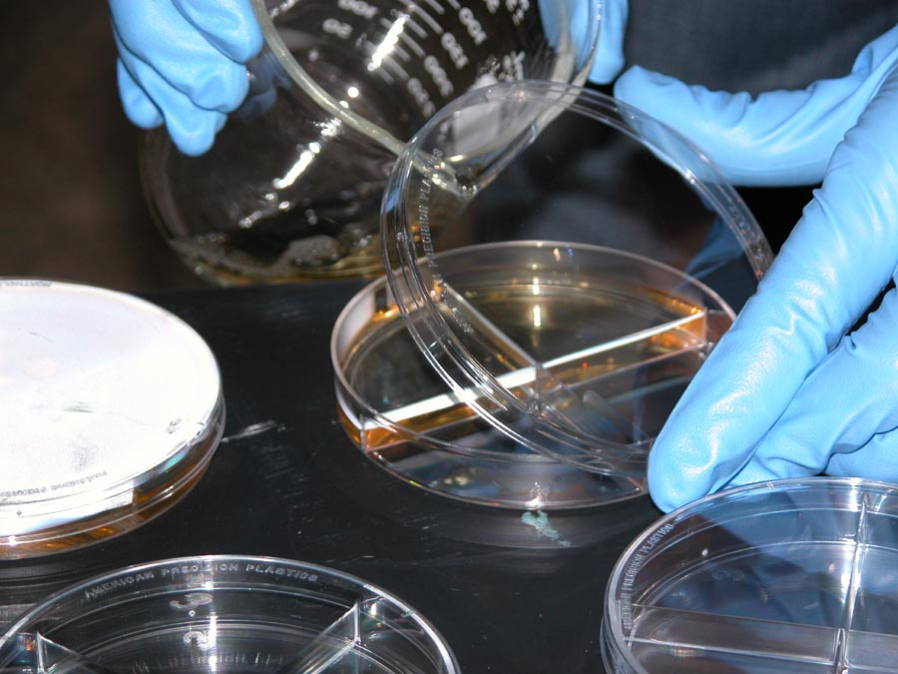
Microbiological Methods
Making Media
Pouring Culture Plates
Sterile Technique
Inoculating Plates and Culture Tubes

Slide 29
Culturing Microorganisms
There are two basic culture techniques used in microbiology:
Liquid culture: bacteria, algae, and some fungi can be reared in culture tubes (test tubes) in a liquid medium.
Liquid medium is best when you want to rapidly increase the concentration of the organism or when you want to grow motile cells.

Slide 30
Culturing Microorganisms
There are two basic culture techniques used in microbiology:
Culture Plates: Liquid medium is solidified using agar (agarose) and poured as a thin layer in the bottom of a culture dish (also sometimes called petri plate)
Culture plates are used when you want to test (1) antibiotic sensitivity, (2) estimate culture concentrations from environmental samples, or (3) isolate individual colonies from environmental samples.

Slide 31
Sterile Technique
When culturing bacteria or other microorganisms, it is important to keep your work area as clean as possible.
This prevents the introduction of other microorganisms from the environment into your culture.
The techniques used to prevent contamination are referred to as sterile techniques.

Slide 32
Sterile Technique
When culturing bacteria or other microorganisms, it is important to keep your work area as clean as possible.
This prevents the introduction of other microorganisms from the environment into your culture.
The techniques used to prevent contamination are referred to as sterile techniques.

Slide 33
Sterile Technique (4)
Don’t forget to wash you hands after you finish cleaning and put on a pair of sterile disposable gloves before you begin.
Once your work area is clean, your hands are clean, and your glassware is clean and sterile, don’t contaminate the work area by placing “dirty items” such as pencils, pens, notes, or books in the sterile work area.

Slide 34
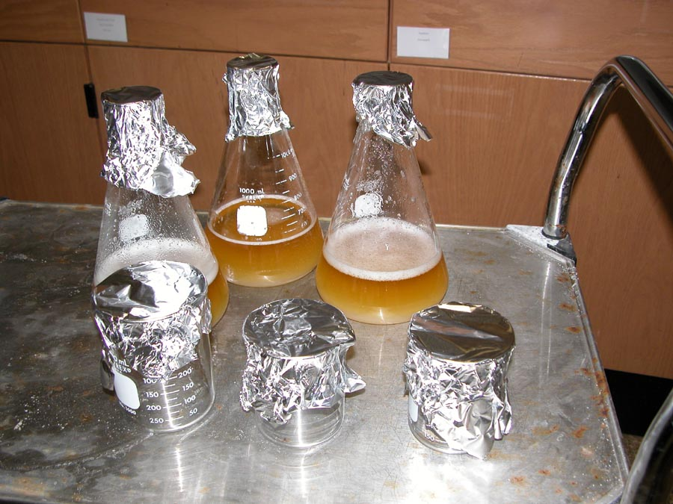
Media Preparation

Slide 35
Microbiological Media
The type of growth medium that you use is a function of the organisms that you want to culture. Use a reference book (there are many) to determine the type of medium that is best suited for your organism of interest.
Common media include Luria Broth (LB), Nutrient Agar, Potato-Dextrose Agar (PDA), Bold’s Basal Medium (BBM)….

Slide 36
Luria Broth
Liquid Medium
10 g Bacto-Tryptone
5 g Bacto-yeast extract
5 g NaCl
Distilled H₂O to 1 l volume
Adjust pH to 7.0
Sterilize for 45 minutes using autoclave or pressure cooker
Plate Medium
10 g Bacto-Tryptone
5 g Bacto-yeast extract
5 g NaCl
Distilled H₂O to 1 l volume
20 g agarose
Adjust pH to 7.0
Sterilize for 45 minutes using autoclave or pressure cooker

Slide 37
Luria Broth
Things to remember:
The volume of media (liquid or plate) should be roughly ½ the volume of the container in which it is placed for sterilization realizing that the liquid expands under increased heat and pressure during the sterilization process.
Estimate plate quantities (how many you need to make) as a function of 15-20 ml per plate.

Slide 38
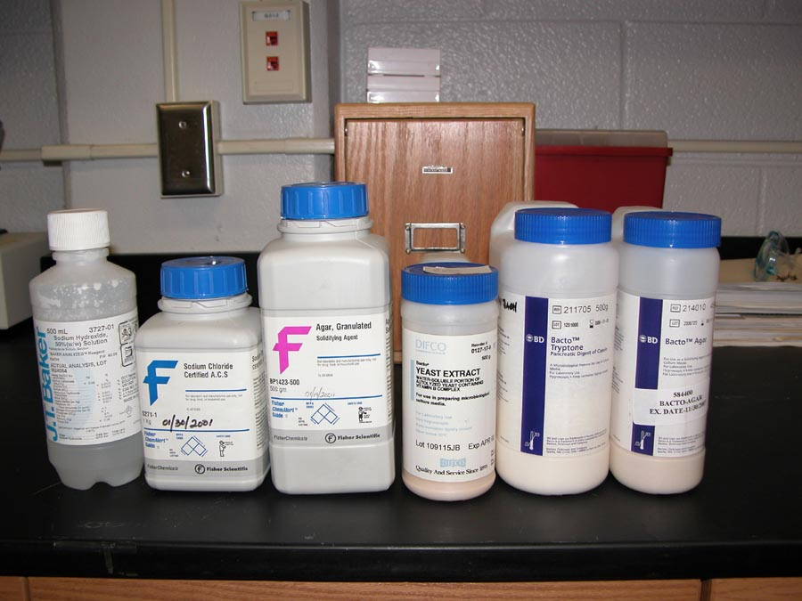
Assemble all of your chemicals in your work area before you begin.

Slide 39
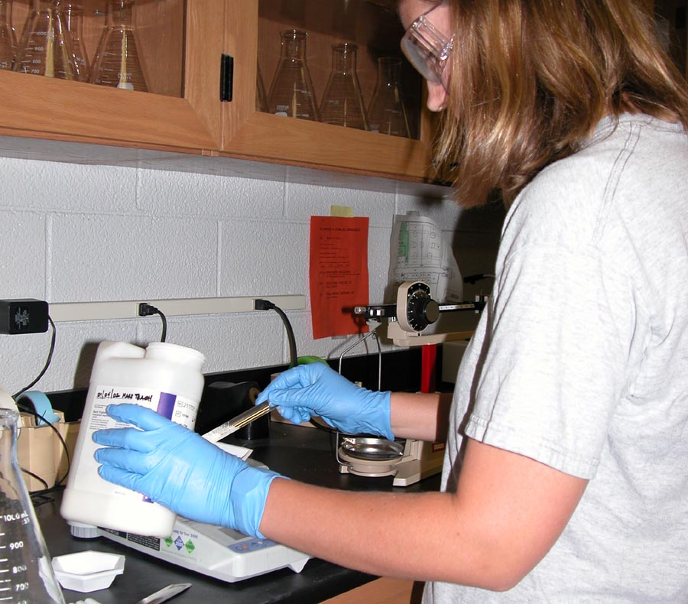
Accurately weigh each of the dry ingredients in your culture media.

Slide 40
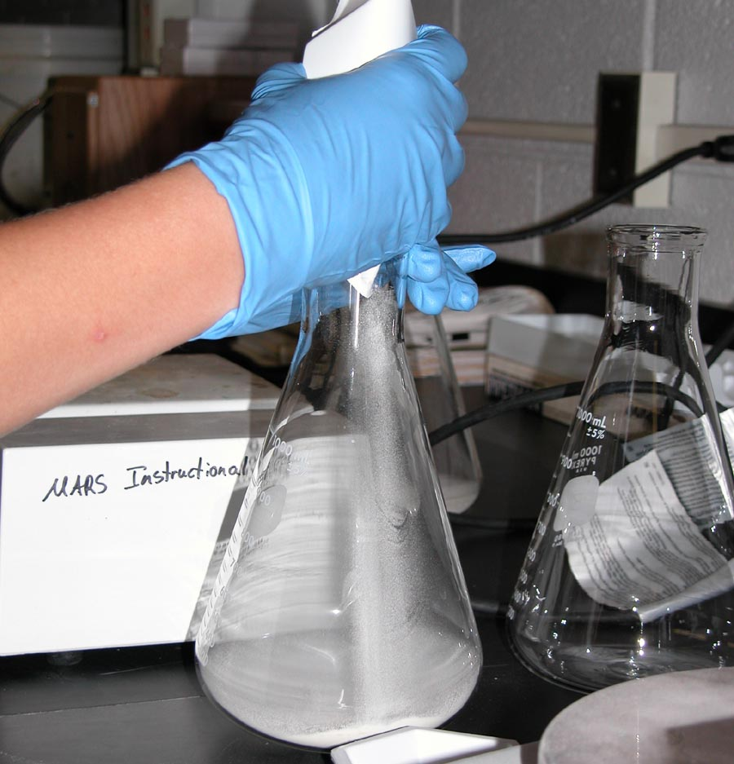
Add each dry culture medium ingredient to the culture flask.

Slide 41
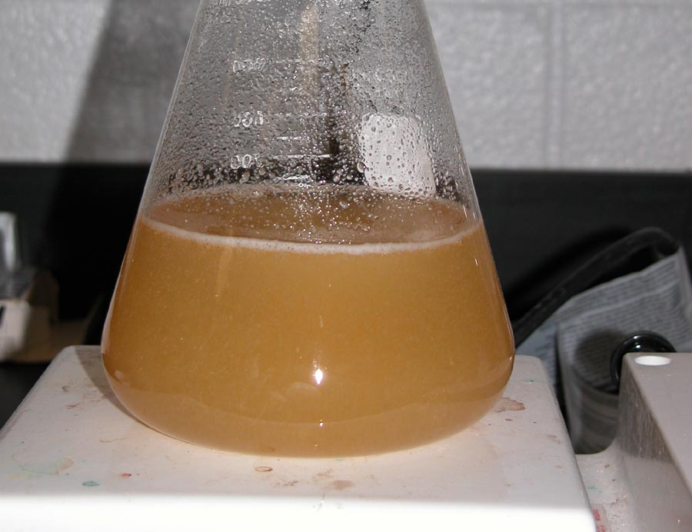
Add distilled (or deionized) water to make the correct volume. Heat AND stir (agar will burn if it is not stirred) until all of the ingredients go into solution. When the media boils, it is ready for sterilization.

Slide 42
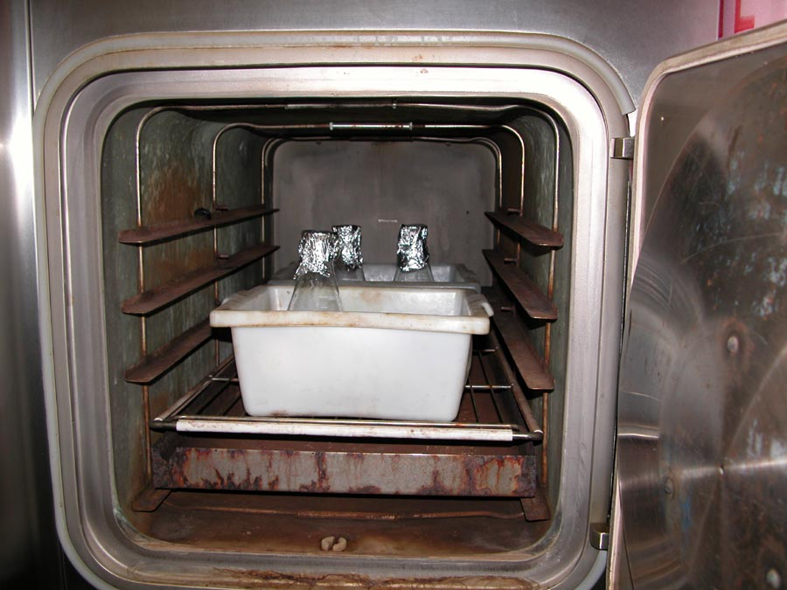
Media Sterilization

Slide 43
Media Sterilization
There are two reliable methods used to sterilize microbial culture media:
autoclave
pressure cooker
When using an autoclave, use the “wet” setting for sterilizing liquids (flasks, bottles, culture tubes, etc), and use the “dry” setting when sterilizing empty containers, stoppers, etc.

Slide 44
Media Sterilization (2)
All liquid media should be sterilized for a minimum for 45 minutes at high temperature and pressure. Autoclaves will cycle automatically, but if you use a pressure cooker, set a timer.
Remember not to tighten the cap or seal on any container; it will explode under high pressure and temperature!
Notes:
Teachers, please note safety precaution regarding tightening lids on containers prior to sterilization.

Slide 45
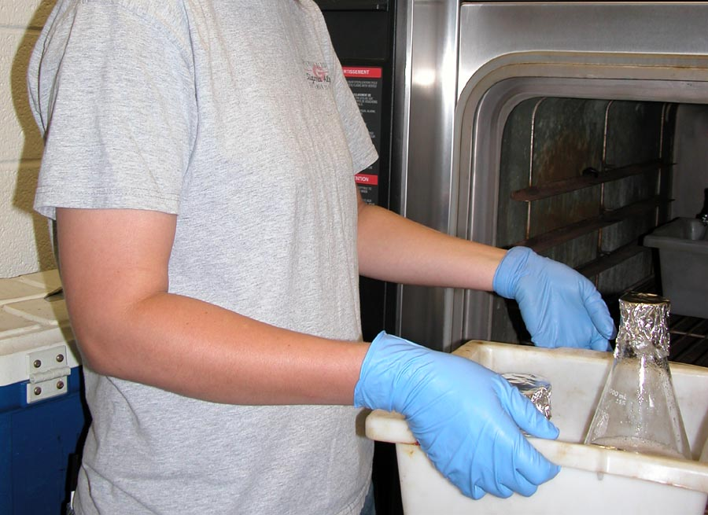
Sterilize for 45 minutes using the wet cycle (autoclave) or at maximum pressure in a pressure cooker. Remember to cover the top of the flask or jar with aluminum foil to prevent contamination when as the media cools.

Slide 46
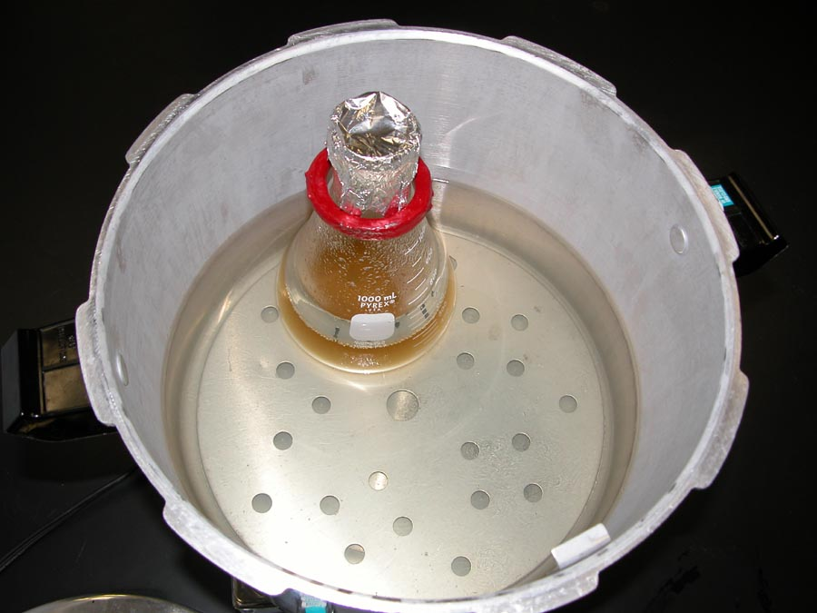
When using a pressure cooker, don’t over fill the cooker, and remember to weight your containers so they don’t fall over!
Notes:
Commercial weights can be purchased from VWR, Fisher Scientific, or other supply companies. These specialized items are generally not available from Carolina Biological Supply or Wards Natural Science. You may be able to make weights in the welding shop from scrap metal.

Slide 47
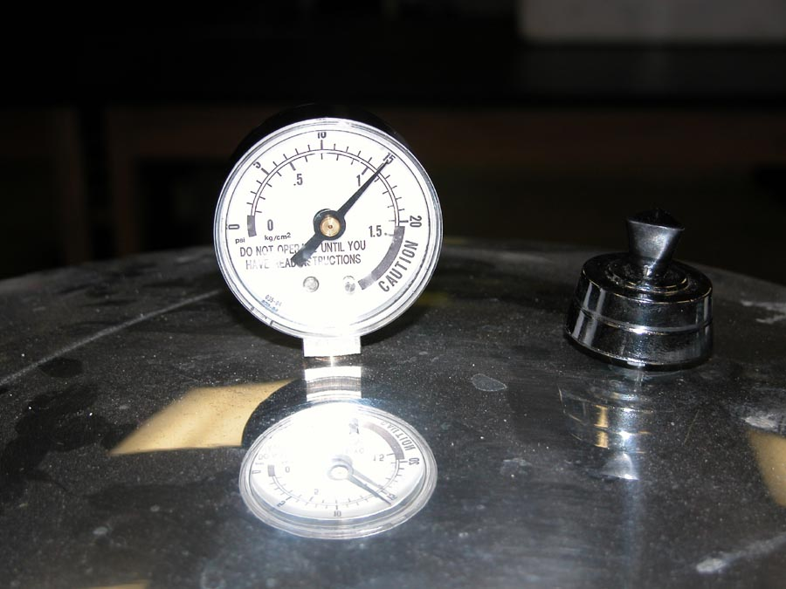
Sterilize at high temperature and pressure for 45 minutes before turning off the heat. Remember to allow enough time for the pot to heat up!

Slide 48
Plate Pouring Tips
Line empty plates along the edge of the work bench.
Open the petri dish lid at about a 30-45° angle to allow the hot liquid to cover the bottom of the dish. The thermal current created by the hot media prevents bacteria and fungal spores from landing in your clean dish.

Slide 49
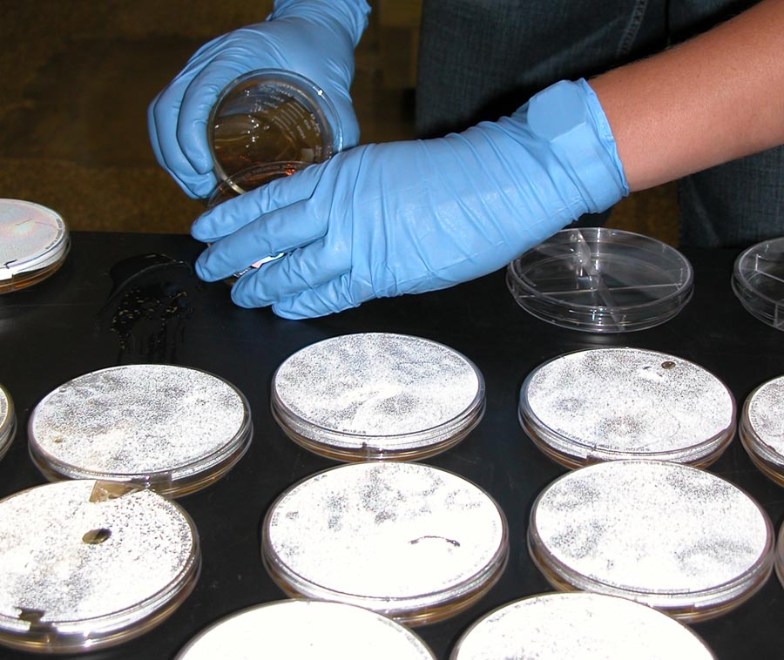
Line your sterile petri plates along the edge of the table. Transfer hot media to a small sterile container and pour 15-20 ml of the plate media into each petri plate. The petri plate lid should be open slightly, but not completely open as this increases contamination.

Slide 50
Plate Pouring Tips
As the plates are poured, move the filled plates to the back of the table until the plates cool and congeal.
Once the plates have cooled and the media is firm, store the plates media side-up (bottom) with the lid securely taped or the plates restacked in the manufacturer’s plastic sleeve.
To increase the shelf-life of the plates, store in a cool, dry environment until they are used (refrigerator).

Slide 51
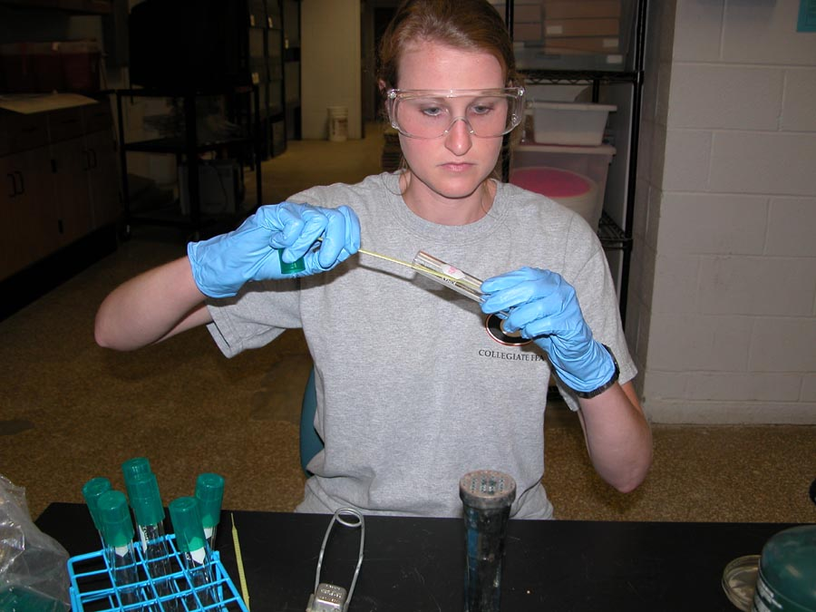
Inoculating Plates and Culture Tubes

Slide 52
Inoculation of Culture Plates and Tubes
Clean and surface sterilize your work area as detailed in the section on Sterile Technique.
Use either disposable inoculation loops or a metal loop that can be heat sterilized to inoculate plates, slants, and liquid culture tubes.
If using a metal loop, be sure to cool the loop by touching the sterile cooled liquid media or the sterile culture plate before the placing the loop in your live culture. Failure to cool the loop will kill your active microbial cultures!

Slide 53
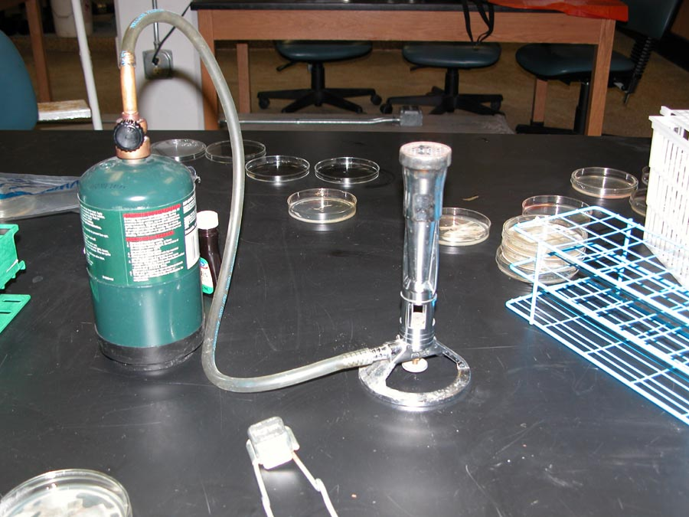
If gas is unavailable in your lab area, you can modify a standard Bunsen burner to use camp stove propane containers as fuel.

Slide 54
Inoculation of Liquid and Solid (Slant) Culture Tubes
Step 1: Remove the culture tube stopper or cap with one (do not set it down) and flame the mouth of the tube to surface sterilize the mouth. The heated tube surface will generate a thermal current that prevents contamination of the culture.

Slide 55
Inoculation of Liquid and Solid (Slant) Culture Tubes
Step 2: Without setting any of the culture materials on the bench, place the sterile inoculation loop in the culture.
Step 3: Replace cap on the culture tube with the active microbes and put it in the test tube rack.
Step 4: Without setting the loop down, pick-up a sterile fresh culture tube with media with one hand, and remove the cap with the other hand.

Slide 56
Inoculation of Liquid and Solid (Slant) Culture Tubes
Step 5: Flame the mouth of the clean culture tube.
Step 6: Place the inoculation loop containing the microbes in the fresh media and swirl the loop in the loop in the media to ensure even dispersal in the media.
Step 7: If using a solid media slant tube, follow steps 1-5 and then zig-zag the inoculation loop across the slanted surface of the solid media in the tube.

Slide 57
Notes:
Note that the culture tube cap is still in the student’s right hand while she holds the liquid culture tube with her left hand. She uses her dominant hand to place the loop in the sterile media.

Slide 58
Inoculation of Liquid and Solid (Slant) Culture Tubes
Step 8: Flame the mouth of the newly inoculated culture tube and replace the cap.
Step 9: Place the culture tube in test tube rack.
Step 10: Repeat until all of the sterile tubes have been inoculated. Use a fresh disposable culture loop for each tube or flame the metal loop after each tube has been inoculated.

Slide 59
Inoculation of Liquid and Solid (Slant) Culture Tubes
Step 11: Incubate the culture at the recommended temperature (check with your supplier for growth requirements). If using environmental samples, incubation at room temperature will avoid the accidental culture of human pathogens.
Step 12: Dispose of all culture materials in a biohazard bag and sterilize all old cultures before pouring out cultures and washing culture tubes. Disposable culture dishes should be melted in an autoclave or pressure cooker prior to disposal.

Slide 60
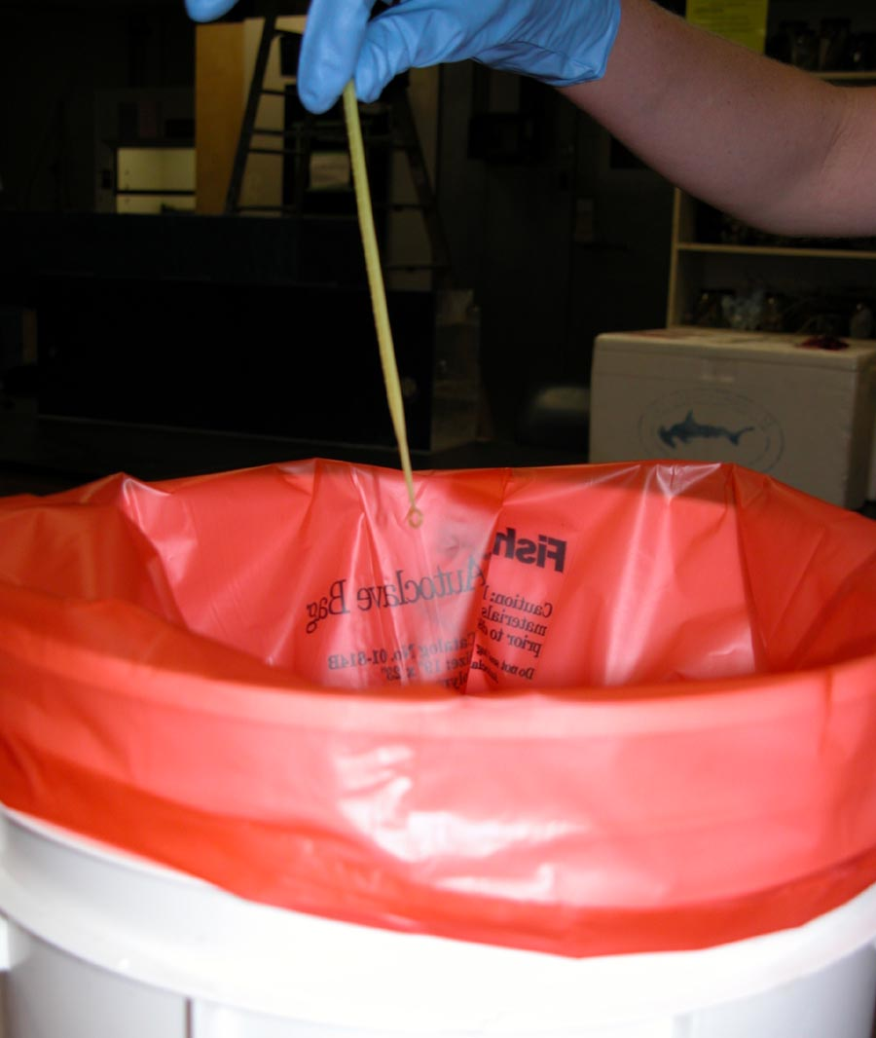
Notes:
Safety Note: Use orange biohazard bags to dispose of all solid waste (disposable loops, used gloves, old culture plates) associated with microbial cultures. These bags are engineered to take the heat and pressure of an autoclave without breaking so that contaminated materials are handled safely. Scientific supply houses also sell autoclave tape; this tape changes color or surface pattern when exposed to high heat and pressure. This tape can be used to remind you what has been sterilized and what needs to be sterilized prior to disposal.

Slide 61
Thanks!!!!!!!!!
Thanks to All.

